Slide 1
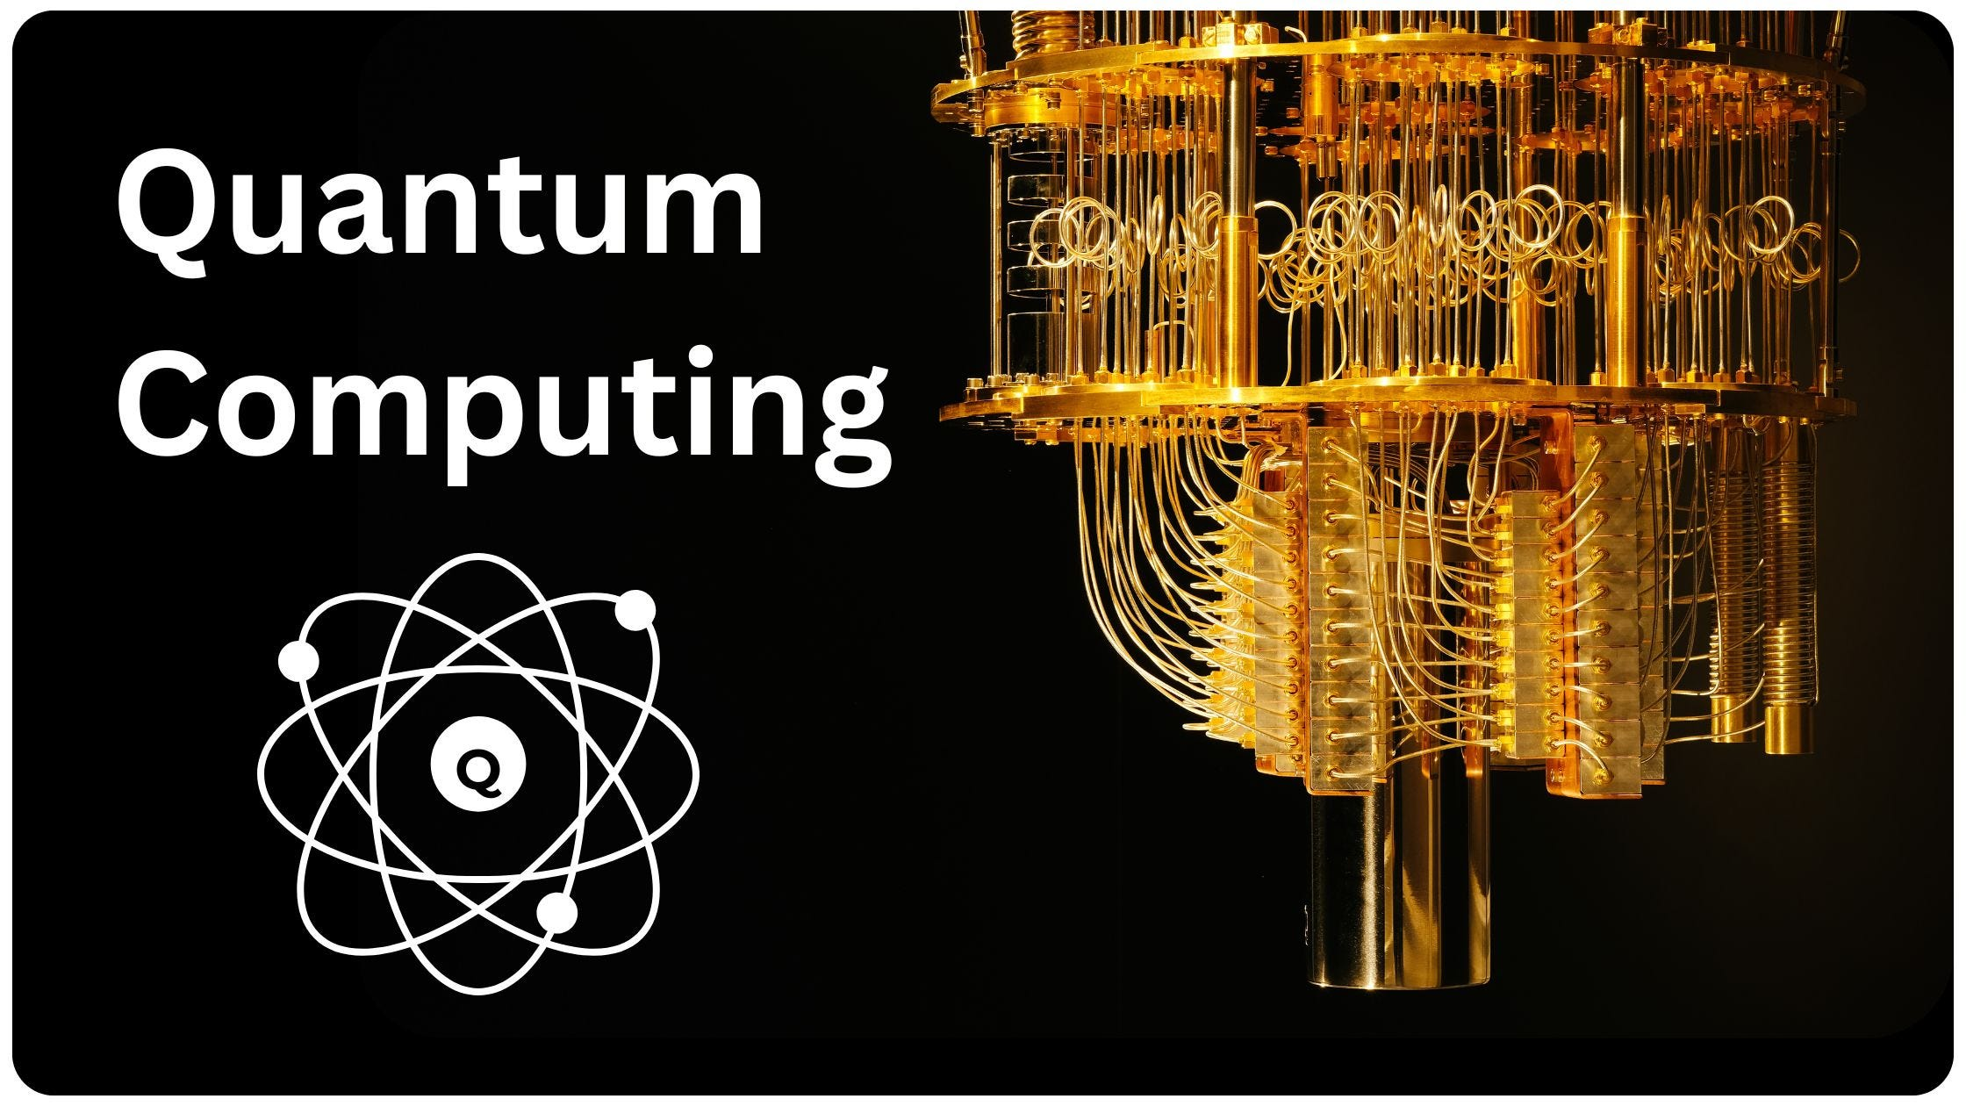
Sk Mamun Islam
Madhav Dubey Lovely Professional University TransOrg

Slide 2
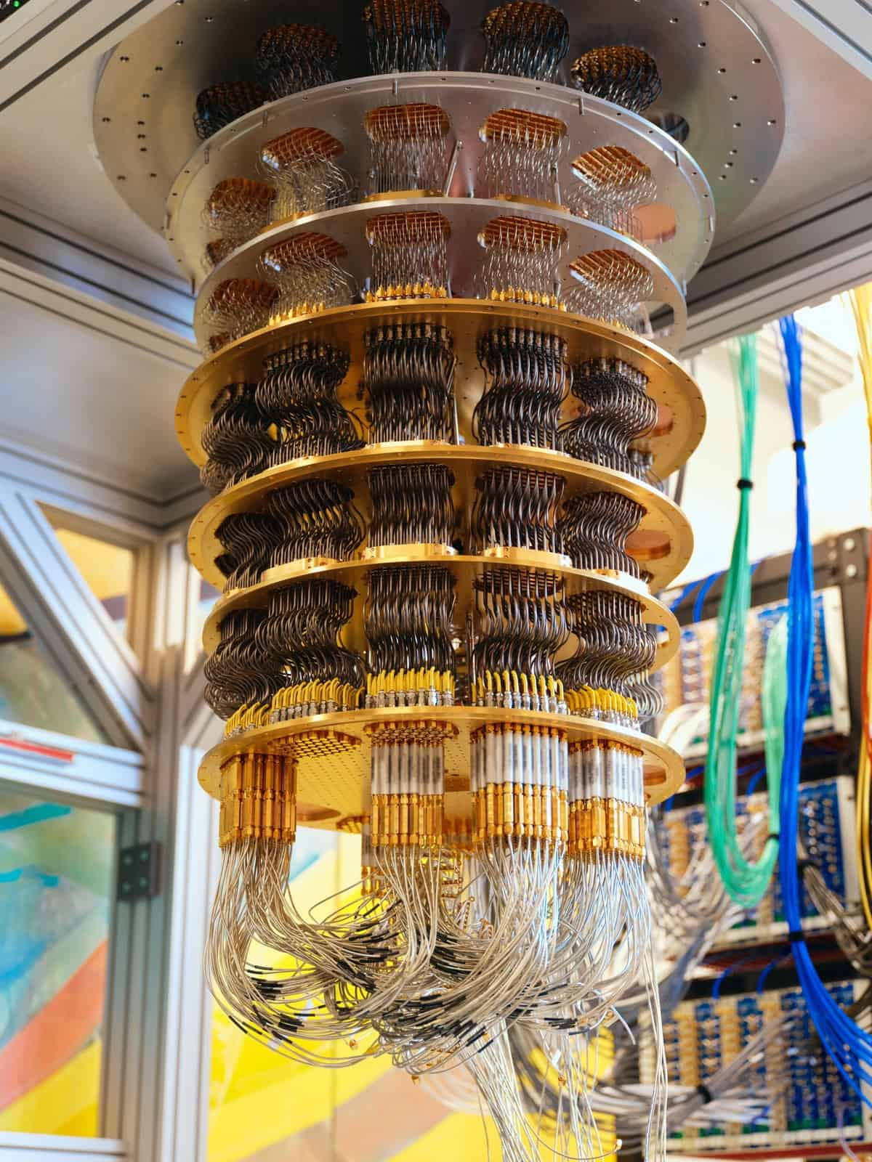
What is Quantum Computing ?
Quantum computing is an advanced computing paradigm that uses the principles of quantum mechanics to process information exponentially faster than classical computers for certain tasks.
1. Cryptography & Security
Breaking classical encryption and developing quantum-safe cryptographic algorithms.
2. Drug Discovery & Molecular Simulation
Simulates molecules at the quantum level to accelerate new medicines and material design.
3. Optimization Problems
Solves complex optimization tasks in logistics, supply chain, finance, and energy systems.
4. Machine Learning & AI Acceleration
Quantum ML algorithms can process high-dimensional data faster than classical models.

Slide 3
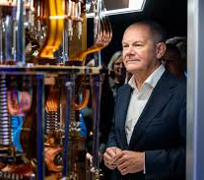
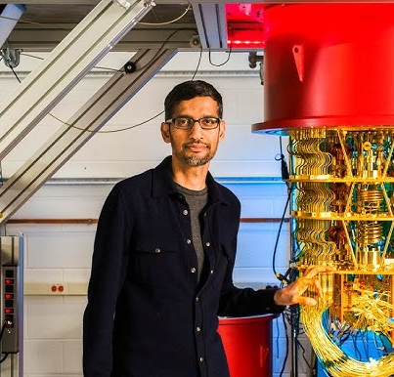

Slide 4
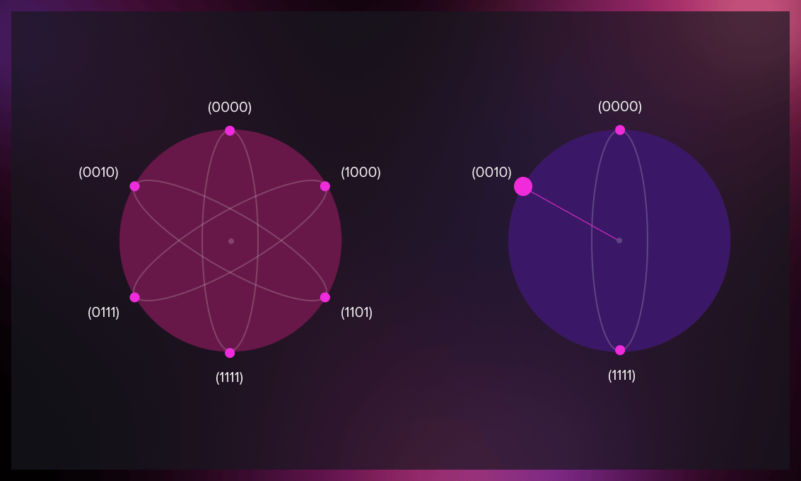
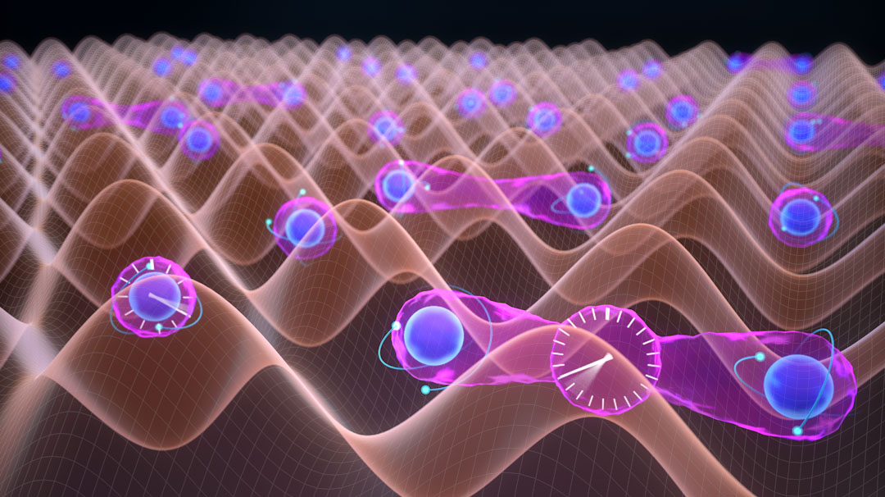

Important Concepts
Qubits: Basic units of quantum information that can exist in multiple states (0 and 1) simultaneously.
Superposition: A qubit can hold multiple states at once, enabling massive parallelism.
Entanglement: Strong correlation between qubits that enables coordinated processing.
Quantum Gates: Operations that manipulate qubits using quantum logic.

Slide 5
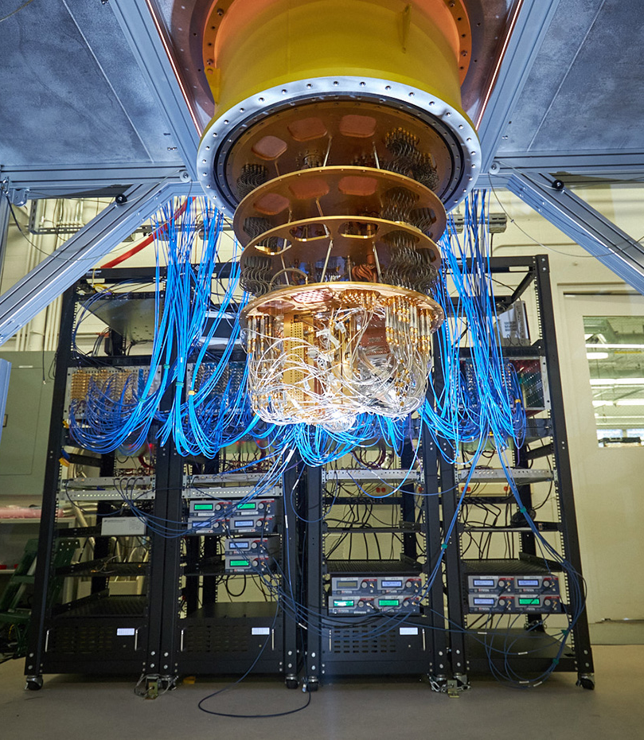
The Problem - Million-Dollar Errors
Quantum computers are highly sensitive to noise, decoherence, and hardware imperfections, which lead to unpredictable errors.
These errors significantly reduce gate fidelity, circuit accuracy, and the overall reliability of quantum computations.
Current quantum hardware lacks real-time prediction of when and where errors will occur.
Without error prediction, quantum algorithms require repeated execution, causing high cost, longer computation time, and low efficiency.
There is a need for an intelligent system that can forecast quantum errors in advance, enabling better circuit optimization and resource utilization.
REAL-WORLD IMPACT:
• System downtime: $50K-$100K per hour
• Hardware damage: $2M-$5M per incident
• Lost research: Priceless quantum data
• Delayed breakthroughs: Competitive disadvantage
CURRENT REALITY: Reactive error detection = Too late!

Slide 6
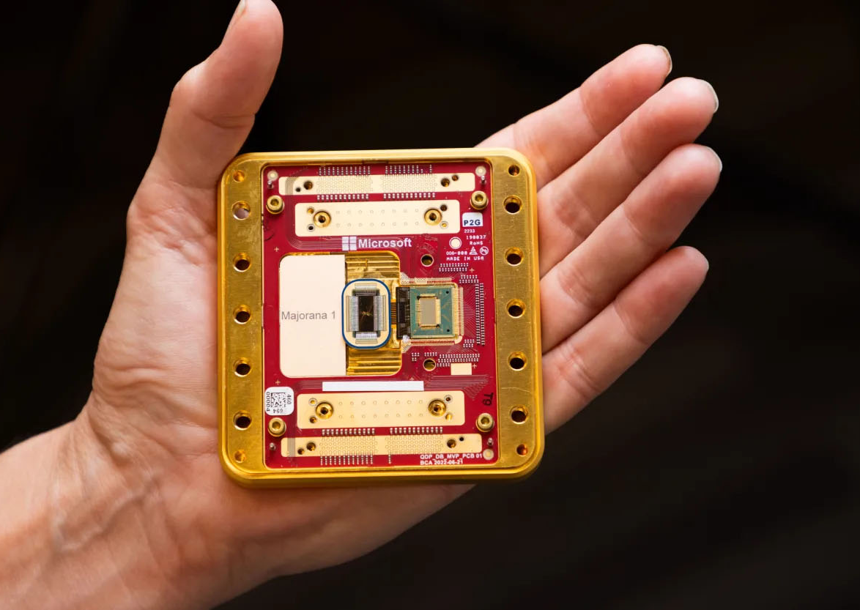
OUR INNOVATION
FROM: Reactive Error Detection
TO: Proactive Error Prevention
• Machine learning models analyze system parameters
• Predict errors BEFORE they occur
• Calculate financial impact of decisions
• Provide actionable recommendations

Slide 7
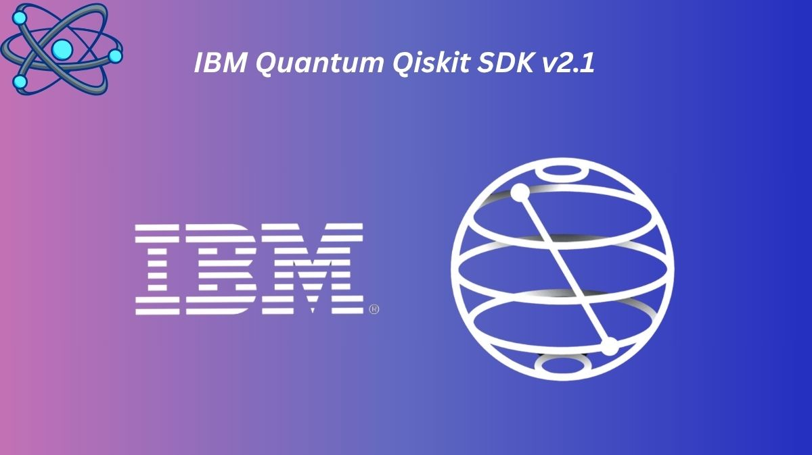
🛠 SYSTEM ARCHITECTURE
DATA FLOW:
Quantum Parameters → ML Model → Prediction → Business Impact
• Data Generation: 15,000 synthetic quantum circuits
• Feature Engineering: Quantum-aware parameters
• Machine Learning: Multiple model comparison
• Web Interface: Real-time predictions
• Business Logic: Financial impact calculation

Slide 8
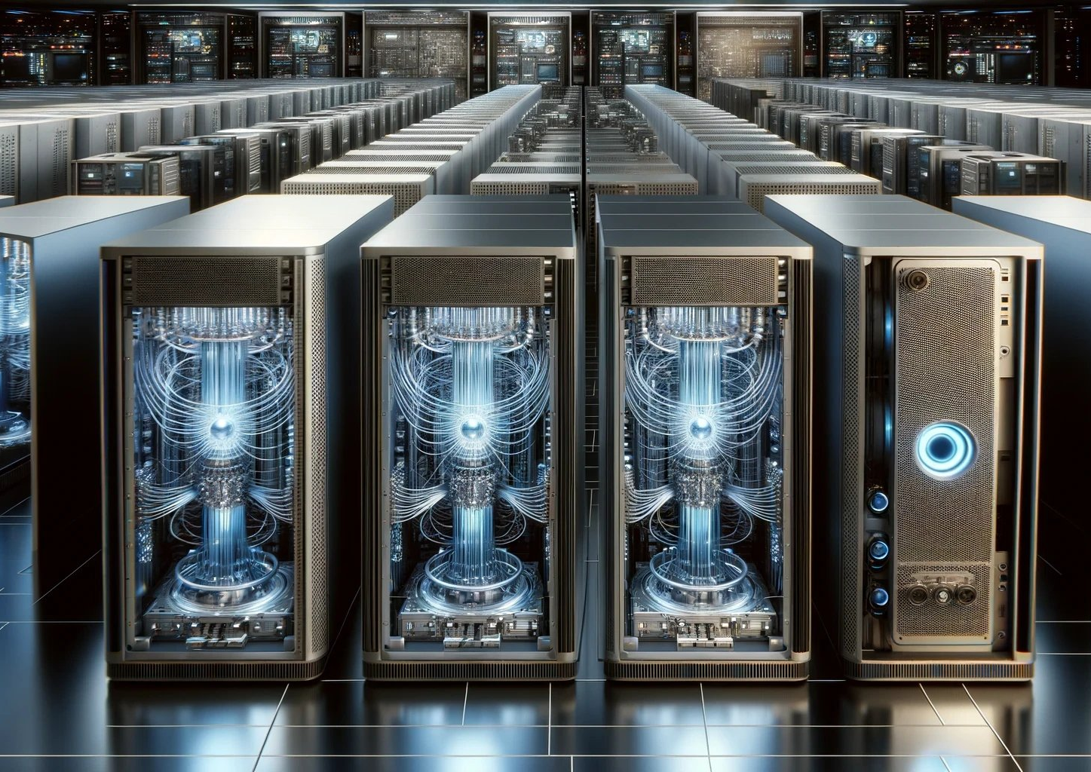
DATA STRATEGY
Gate Fidelity (0.9-0.999)
Coherence Time (10-100μs)
Temperature (10-50mK)
Circuit Complexity metrics
Qubit Connectivity
Crosstalk

Slide 9
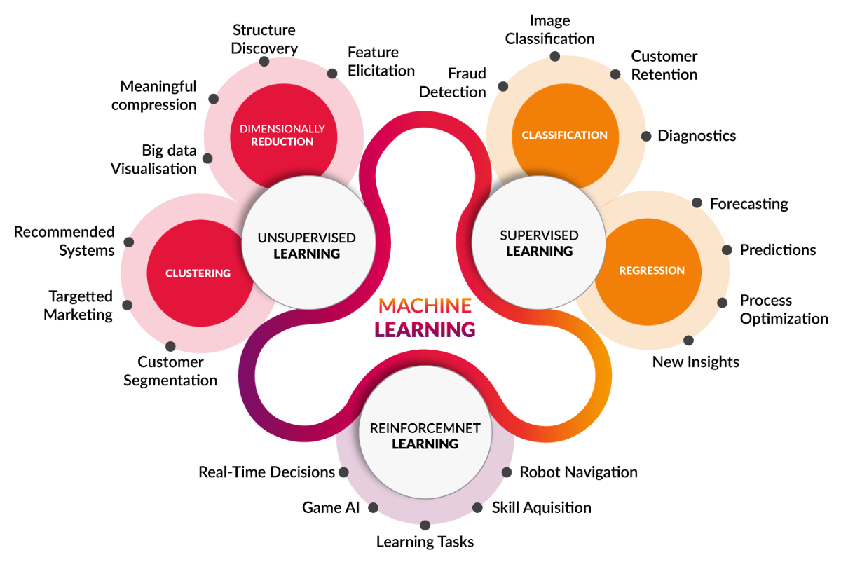
MODEL SELECTION
TESTED 4 ALGORITHMS:
1. Logistic Regression
2. Random Forest
3. Gradient Boosting
4. Support Vector Machines
WHY LOGISTIC REGRESSION WON:
• Best Performance: 87% ROC-AUC
• Fastest Inference: 10ms predictions
• Business Interpretable
• Probabilistic Outputs Perfect for Risk

Slide 10
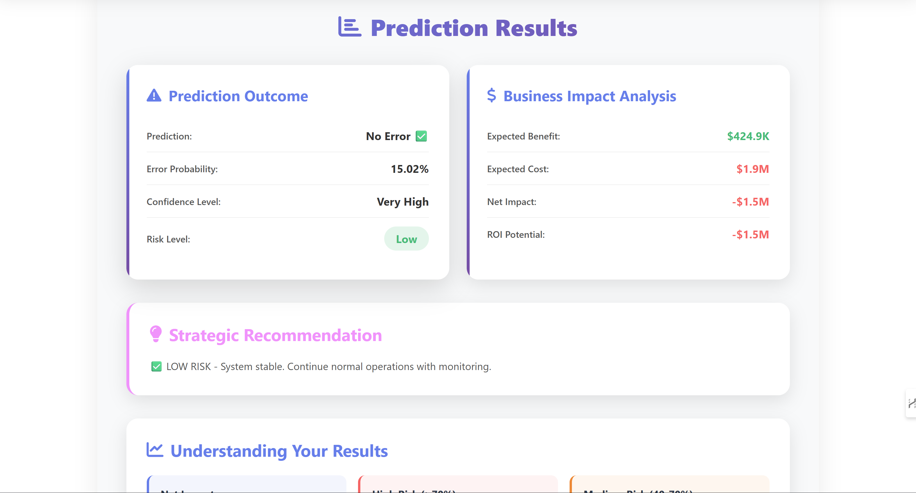

Slide 11
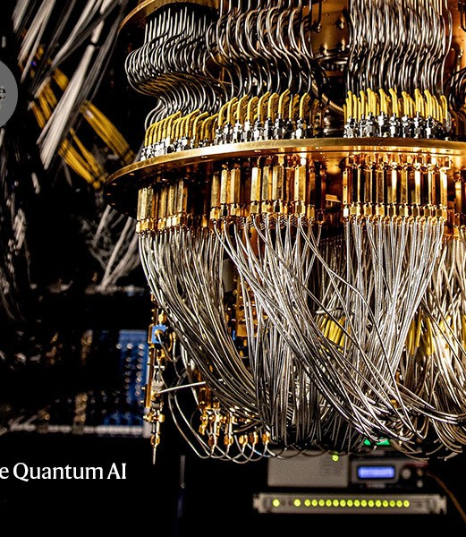
Quantum Computing
Thank you

